Slide 1
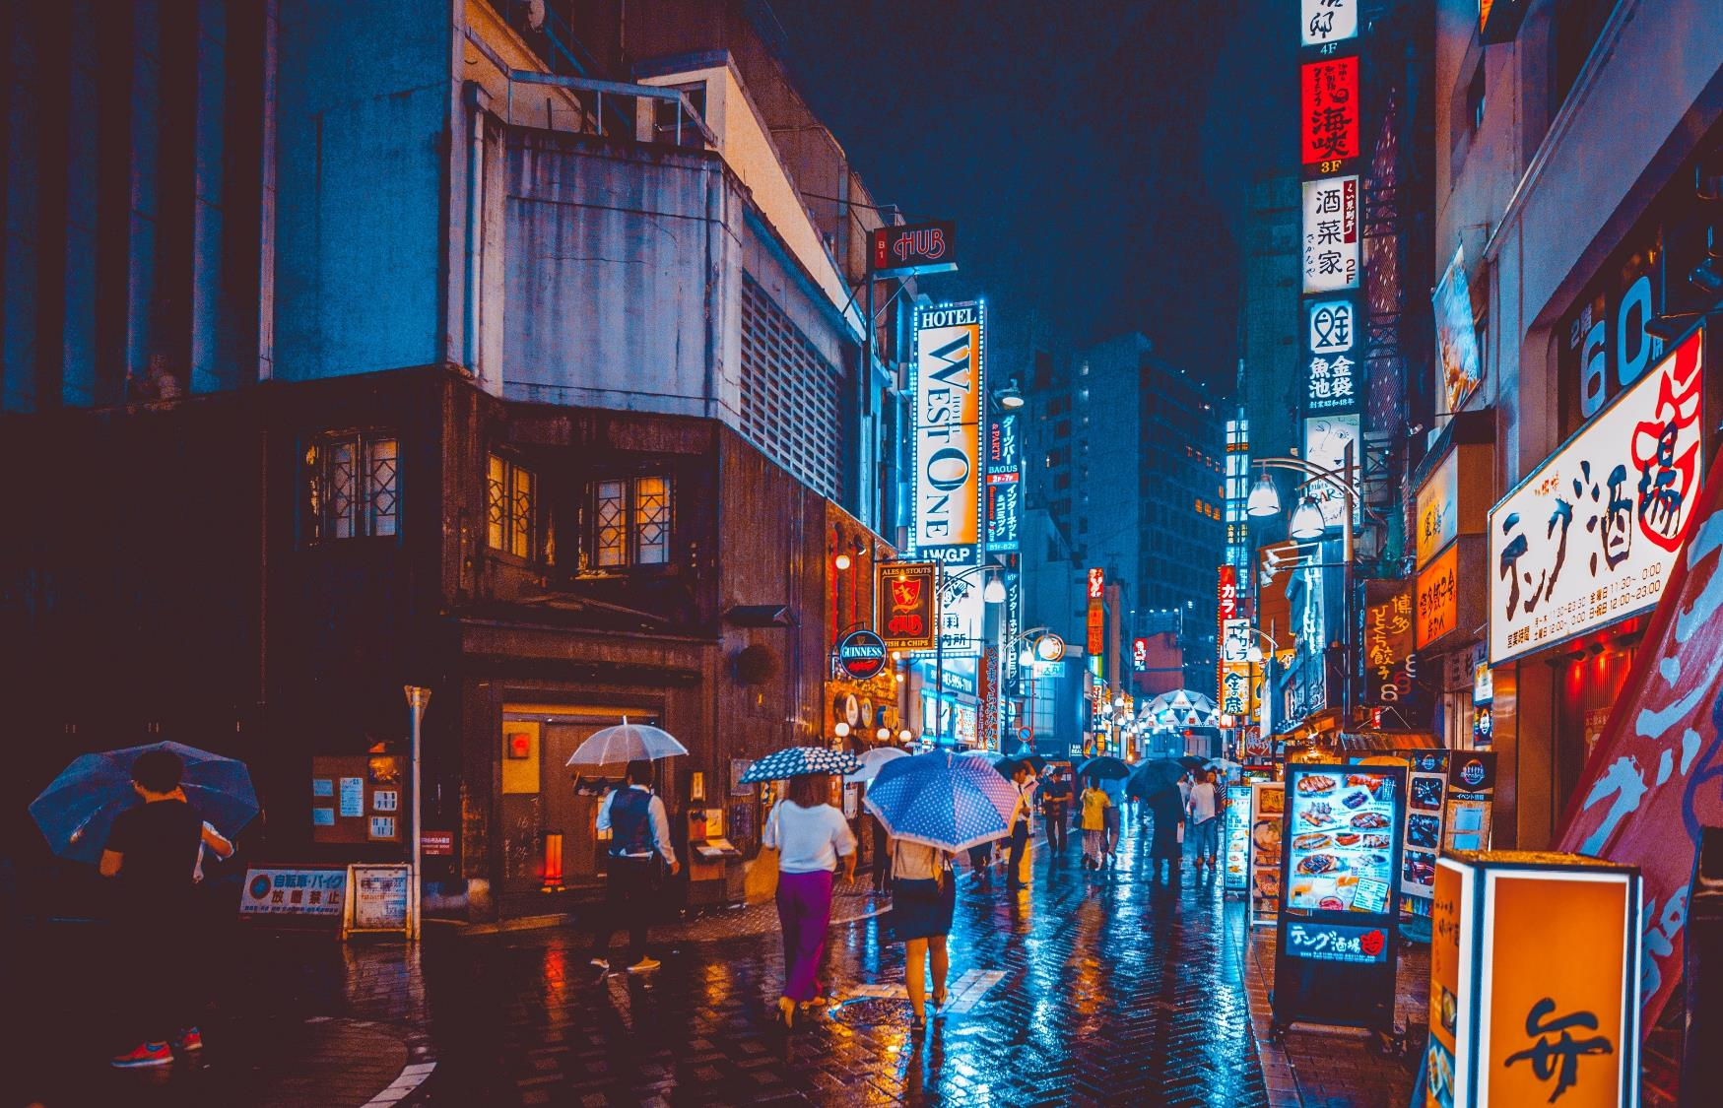
The Battle of Neighbourhoods
Coursera IBM Data Science Certification,
Akshay C A

Slide 2
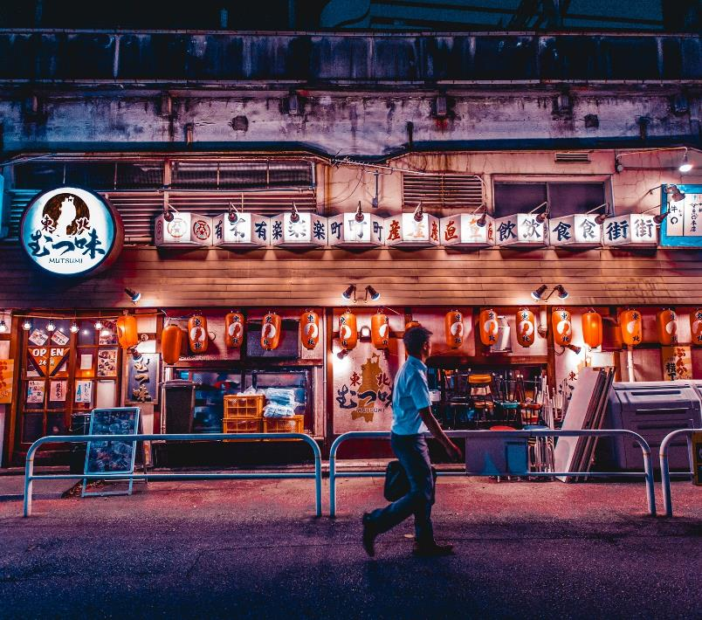
Introduction/Business Problem
Toronto, one of the famous places in world which is diverse and multicultural. I'm planning to move into Toronto but I'm not sure of the exact neighborhood which would be a best fit for me. I would like to explore how much they are similar or dissimilar neighborhoods are aspects from a tourist point of view regarding food, accommodation, beautiful places, and many more.
You should be able to choose, compare different neighborhoods in terms of a service, search for potential explanation of why a neighborhood is popular etc., . Hence the name of the capstone project will be the “Battle of the neighborhoods.”

Slide 3
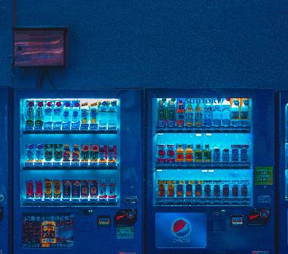
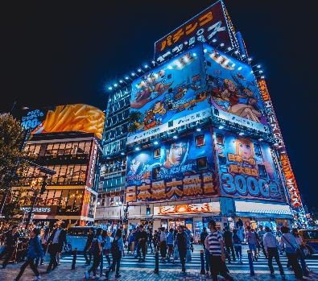
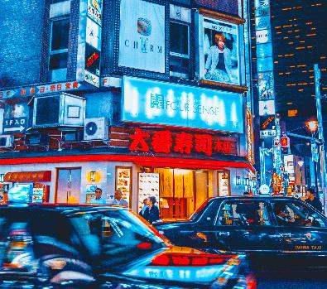
Data
In order to explore the similar or dissimilar in aspects of the neighborhoods, I would need Foursquare location data to fetch the Venue Category and Boroughs of Toronto.
We will segment it into different neighborhoods using the geographical coordinates of the center of each neighborhood, and then using a combination of location data and machine learning.
Building a recommendation system for finding best clusters of neighborhood based on certain criteria is valuable analytical problem that perfectly fits into Clustering type of Data Science problems which could be solved by unsupervised learning algorithms.

Slide 4
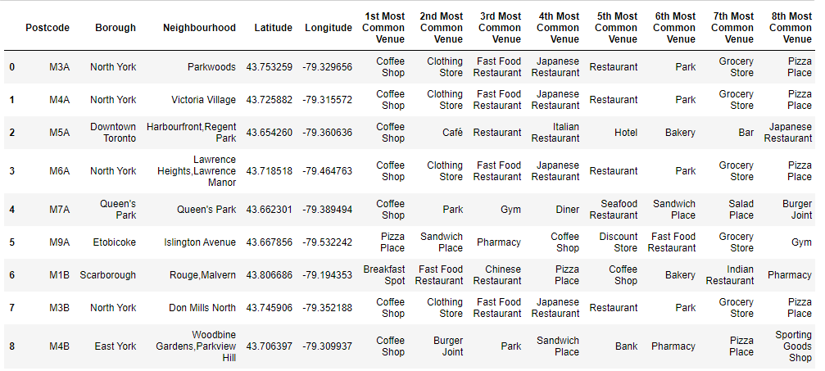
Table
After performing several data transformation our Data frame would look like the below screenshot

Slide 5
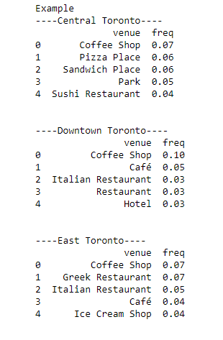
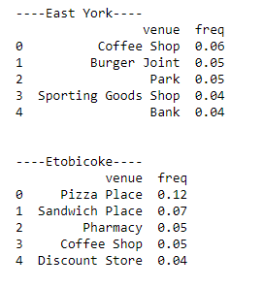
Exploratory Data Analysis
It was found that there are 276 unique categories.
And Borough along with the top 5 most common venues:
Coffee Shops is the most common Venue among all the Borough

Slide 6
Machine Learning – KMeans Clustering
To extract insights from the Data using unsupervised Machine Learning technique
A Clustering Algorithm tries to analyse natural groups of data on the basis of some similarity. It locates the centroid of the group of data points. To carry out effective clustering, the algorithm evaluates the distance between each point from the centroid of the cluster.
K-means Clustering will group these locations of maximum prone areas into clusters and define a cluster centre for each clusters. These Clusters centres are the centroids of each cluster and are at a minimum distance from all the points of a particular cluster.

Slide 7
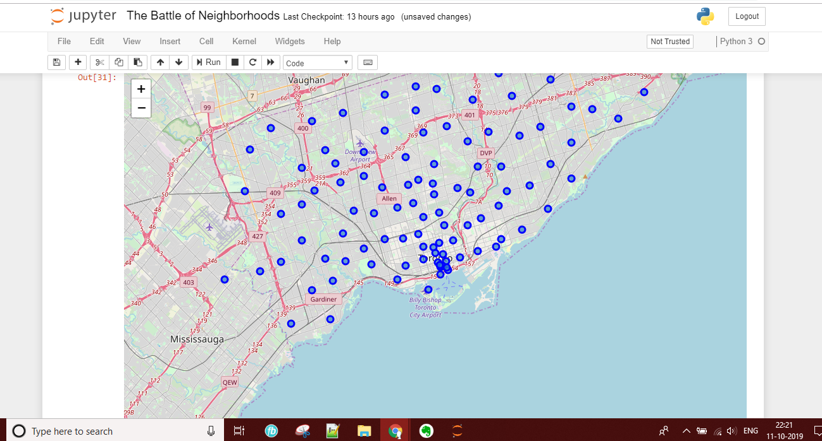
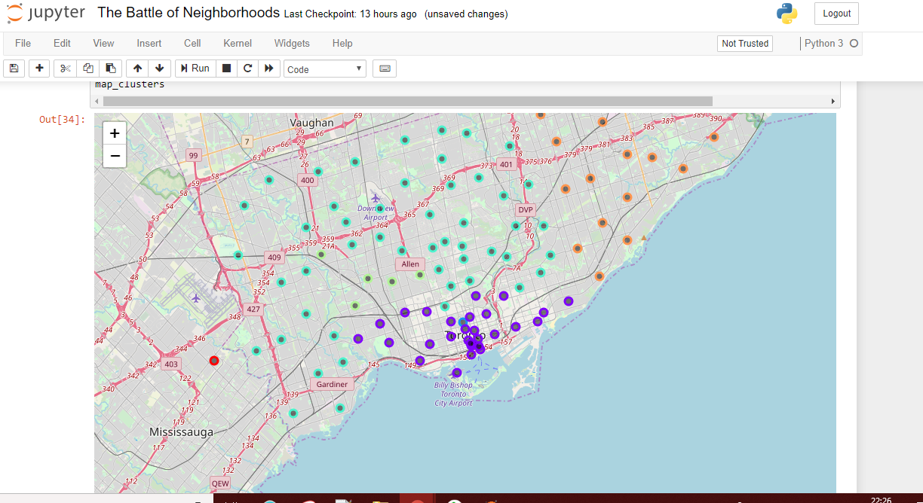
Data Visualization
Visualization of Toronto's Borough V/S Clusters visualization of Toronto's Borough
After applying the Machine learning algorithm it was found to have 5 clusters of similar neighbourhoods as visualized
below

Slide 8
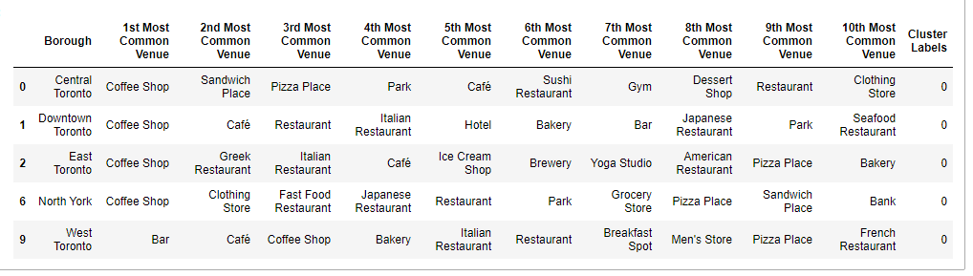
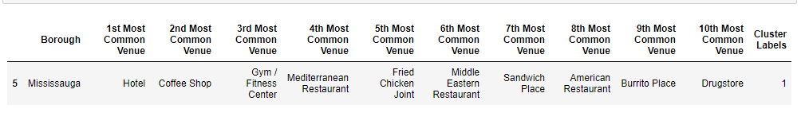
Results and Conclusion
Cluster #0 - Most common venues: Restaurants and Coffee Shop
Cluster #1 -Most common venues: Hotels and Gym/Fitness centre

Slide 9
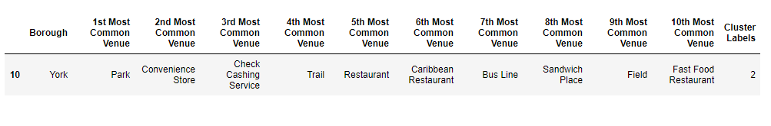
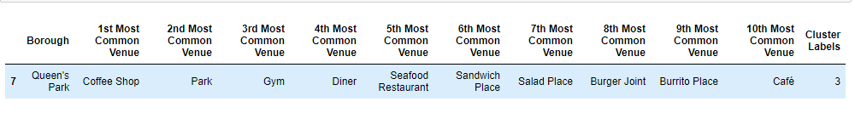
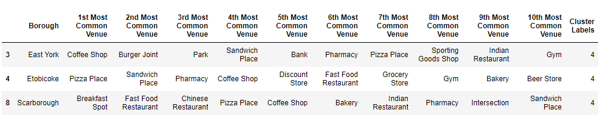
Cluster #2 - Most common venues: Park, Convenience Store and Check Cashing Service
Cluster #3 - Most common venues: Park and Gym
Cluster #4 -Most common venues: Fast Food Restaurants

Slide 10
Looking at the clusters one can make a choice of Neighbourhood which would best suit them.
Example: My personal preference would be a home around Fast Food Restaurants so Cluster #4 Neighborhoods - East York, Etobicoke and Scarborough would be best for me.
In conclusion, this project would have had better results if there were more available data in terms of actual land pricing data within the area, public transportation access and allowance of more venues exploration with the Foursquare (limited venues for free calls).

Slide 11


Thank You
Akshay C A
akshayca42@gmail.com

